Slide 1
Mechanical Vibrations

Slide 2
Contents
Introduction
Free Vibrations of Particles. Simple Harmonic Motion
Simple Pendulum (Approximate Solution)
Simple Pendulum (Exact Solution)
Sample Problem 19.1
Free Vibrations of Rigid Bodies
Sample Problem 19.2
Sample Problem 19.3
Principle of Conservation of Energy
19 - <number>

Slide 3
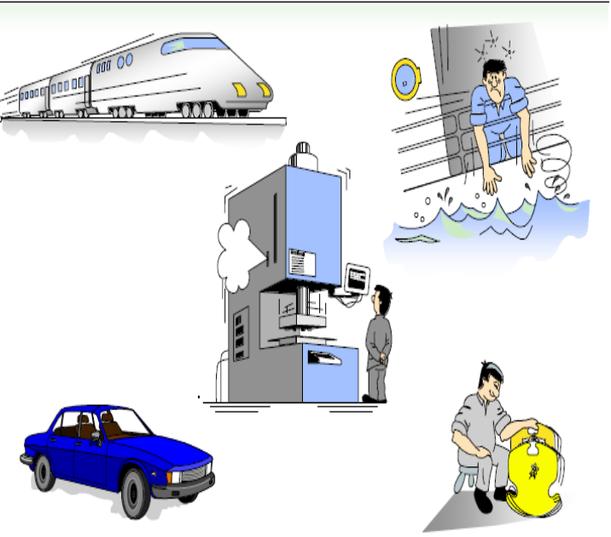
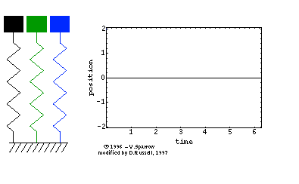
Introduction
Oscillation: Any repeated variation about a central value
Vibration: Mechanical oscillations
Simple Harmonic Motion: motion of a particle or body which oscillates about a position of equilibrium under a restoring force which directly proportional to the object’s displacement.
It is also an everyday phenomenon we meet on everyday life
19 - <number>

Slide 4





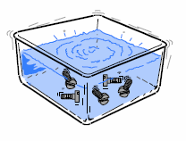
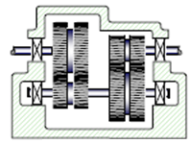
Introduction
Useful Vibration
Harmful vibration
Compressor
Noise
Testing
Destruction
Wear
Ultrasonic cleaning
Fatigue
Most vibrations in machines and structures are undesirable due to increased stresses and energy losses.
19 - <number>

Slide 5
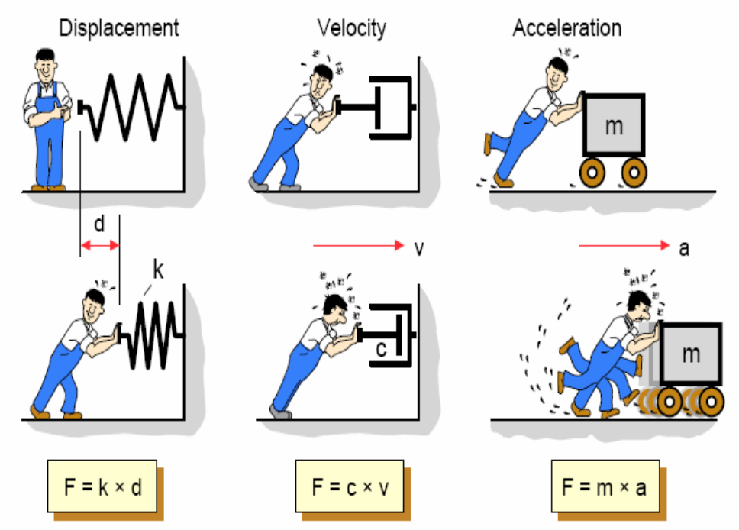
Introduction – Vibration Parameters
All mechanical systems can be modeled by containing three basic components:
spring, damper, mass
When these components are subjected to constant force, they react with a constant
displacement, velocity and acceleration
19 - <number>

Slide 6
Introduction – Vibration Parameters
Time interval required for a system to complete a full cycle of the motion is the period of the vibration.
Number of cycles per unit time defines the frequency of the vibrations.
Maximum displacement of the system from the equilibrium position is the amplitude of the vibration.
When the motion is maintained by the restoring forces only, the vibration is described as free vibration. When a periodic force is applied to the system, the motion is described as forced vibration.
When the frictional dissipation of energy is neglected, the motion is said to be undamped. Actually, all vibrations are damped to some degree.
19 - <number>

Slide 7
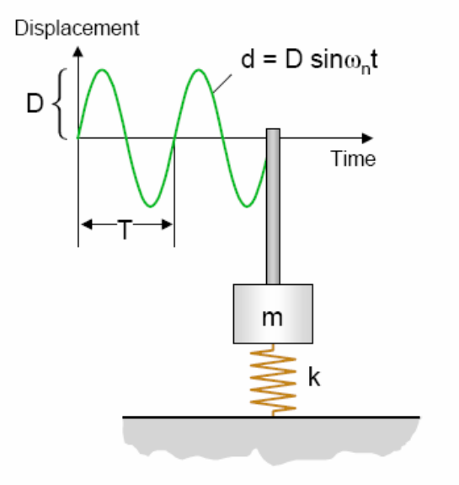
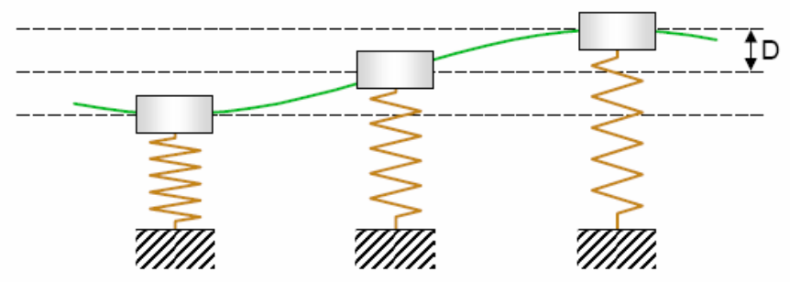
Introduction – Free Vibration
When a system is initially disturbed by a displacement, velocity or acceleration, the system begins to vibrate with a constant amplitude and frequency depend on its stiffness and mass.
This frequency is called as natural frequency, and the form of the vibration is called as mode shapes
Equilibrium pos.
19 - <number>

Slide 8
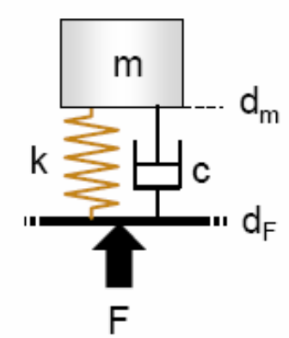
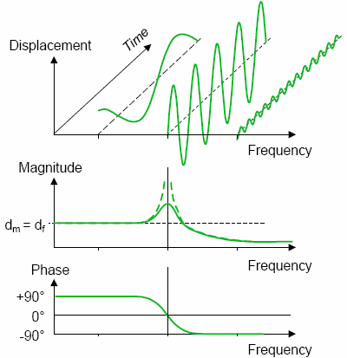
Introduction – Free Vibration
If an external force applied to a system, the system will follow the force with the same frequency.
However, when the force frequency is increased to the system’s natural frequency, amplitudes will dangerously increase in this region. This phenomenon called as “Resonance”
19 - <number>

Slide 9
Introduction – Watch these …
Bridge collapse:
http://www.youtube.com/watch?v=j-zczJXSxnw
Hellicopter resonance: http://www.youtube.com/watch?v=0FeXjhUEXlc
Resonance vibration test:
http://www.youtube.com/watch?v=LV_UuzEznHs
Flutter (Aeordynamically induced vibration) :
http://www.youtube.com/watch?v=OhwLojNerMU
19 - <number>

Slide 10
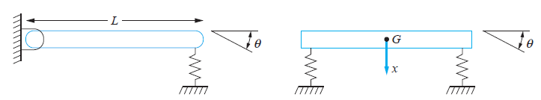
Degree of Freedom (DOF)
Degree of Freedom: The number of independent coordinates required to specify completely the position and orientation of a particle in space, is defined as its “Degree of Freedom”
Mathematical modeling of a physical system requires the selection of a set of variables that describes the behavior of the system.
The number of degrees of freedom for a system is the number of kinematically independent variables necessary to completely describe the motion of every particle in the system
DOF=1
Single degree of freedom (SDOF)
DOF=2
Multi degree of freedom (MDOF)
19 - <number>

Slide 11
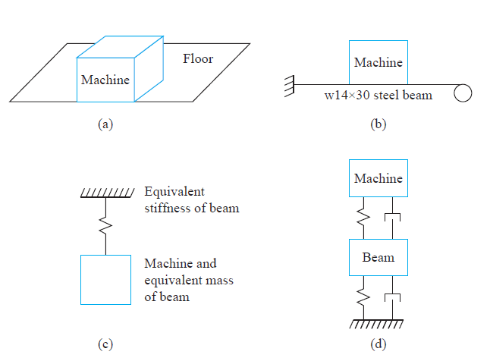
Degree of Freedom (DOF) – Equivalent model of system
Example 1:
Example 2:
SDOF
DOF=1
MDOF
DOF=2
19 - <number>

Slide 12
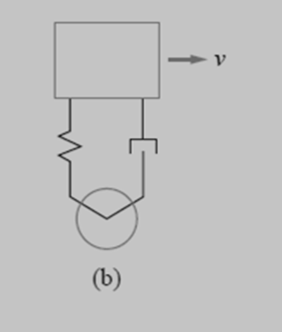
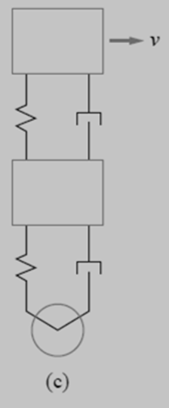
Degree of Freedom (DOF) – Equivalent model of system
Example 3:
SDOF
DOF=2
19 - <number>

Slide 13
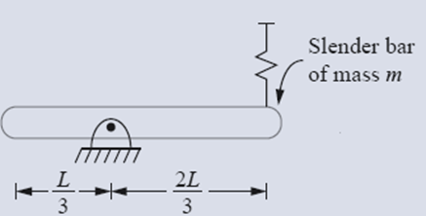
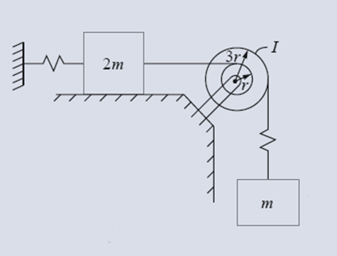
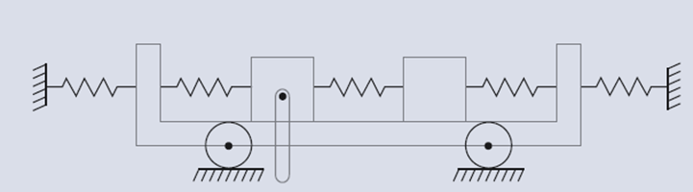
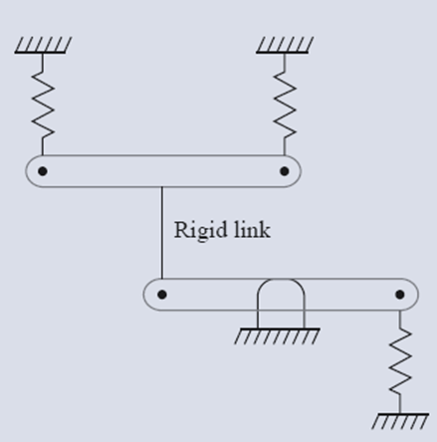
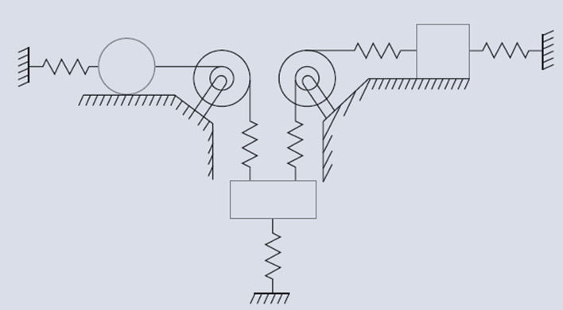
What are their Degrees of Freedom (DOF)
19 - <number>

Slide 14
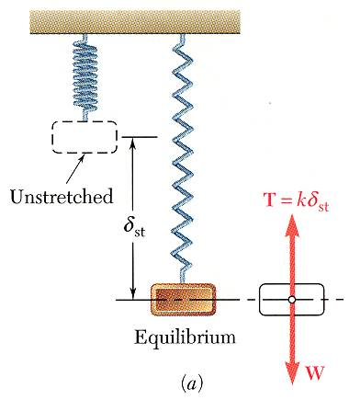

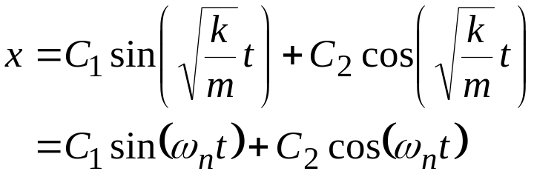
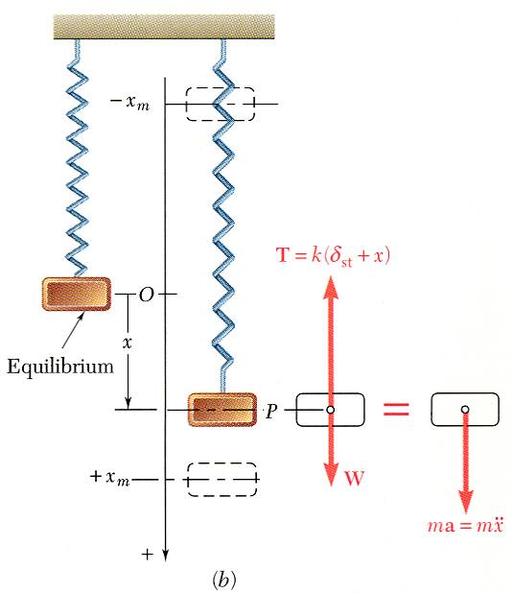



Free Vibrations of Particles. Simple Harmonic Motion
If a particle is displaced through a distance x_{m} from its equilibrium position and released with no velocity, the particle will undergo simple harmonic motion,
General solution is the sum of two particular solutions,
x is a periodic function and ω_{n} is the natural circular frequency of the motion.
C₁ and C₂ are determined by the initial conditions:
19 - <number>

Slide 15
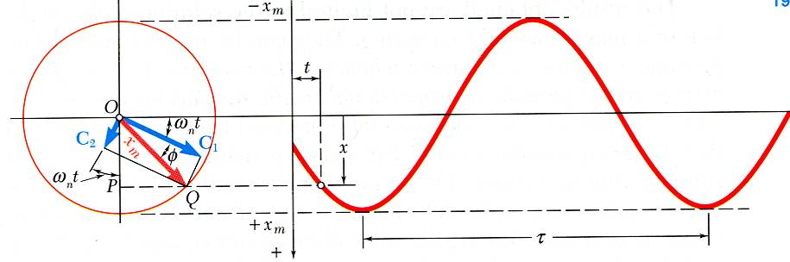
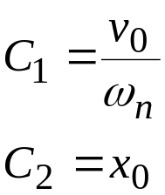





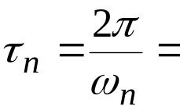
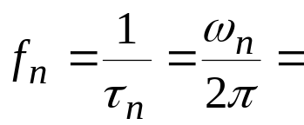
Free Vibrations of Particles. Simple Harmonic Motion
Displacement is equivalent to the x component of the sum of two vectors
which rotate with constant angular velocity
amplitude
phase angle
period
natural frequency
19 - <number>

Slide 16
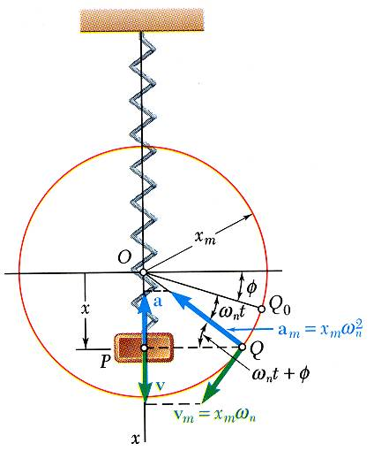
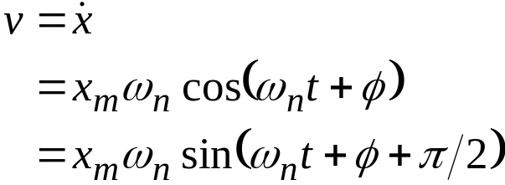
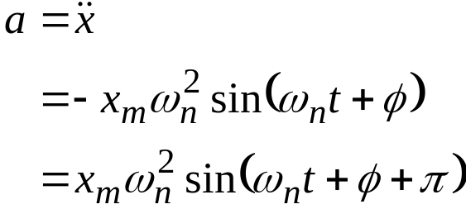
Free Vibrations of Particles. Simple Harmonic Motion
Velocity-time and acceleration-time curves can be represented by sine curves of the same period as the displacement-time curve but different phase angles.
19 - <number>

Slide 17
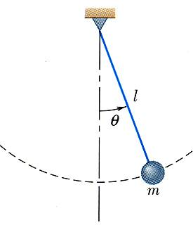



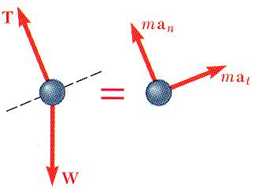
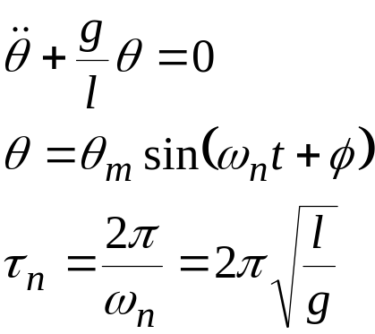
Simple Pendulum (Approximate Solution)
Results obtained for the spring-mass system can be applied whenever the resultant force on a particle is proportional to the displacement and directed towards the equilibrium position.
Consider tangential components of acceleration and force for a simple pendulum,
for small angles,
19 - <number>

Slide 18

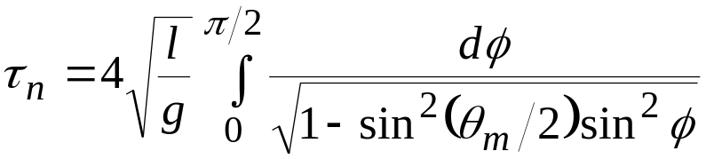
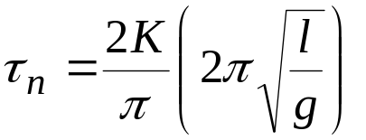
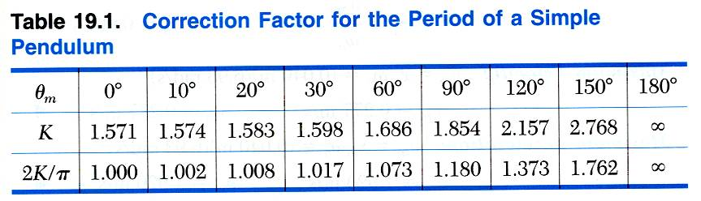
Simple Pendulum (Exact Solution)
An exact solution for
leads to
which requires numerical solution.
19 - <number>

Slide 19
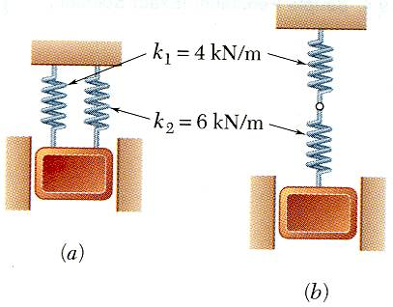
Sample Problem 19.1
SOLUTION:
For each spring arrangement, determine the spring constant for a single equivalent spring.
Apply the approximate relations for the harmonic motion of a spring-mass system.
A 50-kg block moves between vertical guides as shown. The block is pulled 40mm down from its equilibrium position and released.
For each spring arrangement, determine a) the period of the vibration, b) the maximum velocity of the block, and c) the maximum acceleration of the block.
19 - <number>

Slide 20

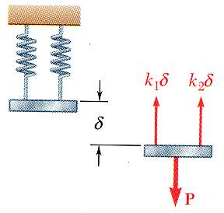
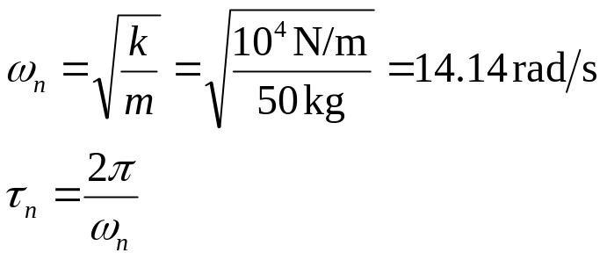

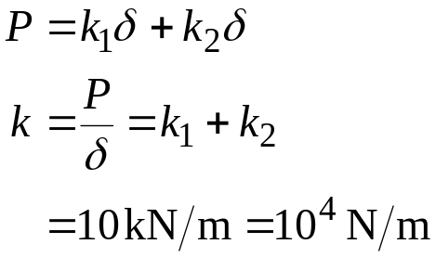
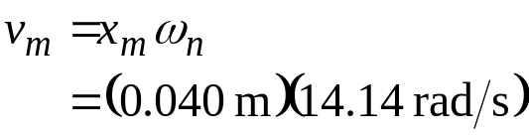

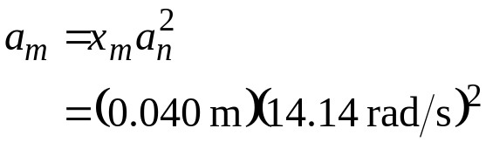

Sample Problem 19.1
SOLUTION:
Springs in parallel:
  determine the spring constant for equivalent spring
  apply the approximate relations for the harmonic motion of a spring-mass system
19 - <number>

Slide 21
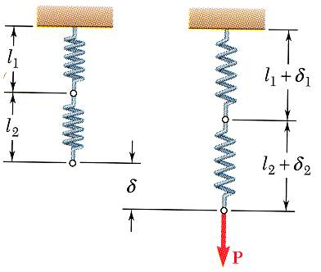
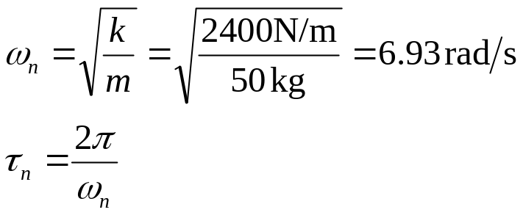

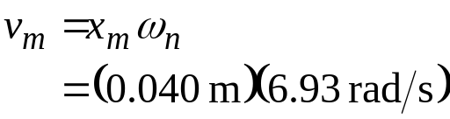

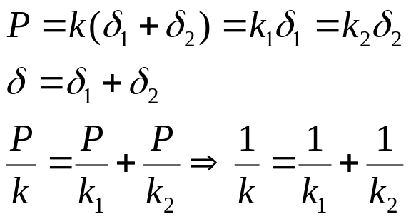
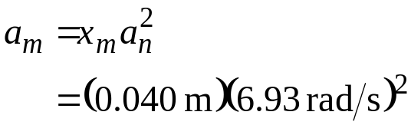

Sample Problem 19.1
Springs in series:
  determine the spring constant for equivalent spring
  apply the approximate relations for the harmonic motion of a spring-mass system
Force that each spring experiences will have to be same and it will also be same as P.
19 - <number>

Slide 22
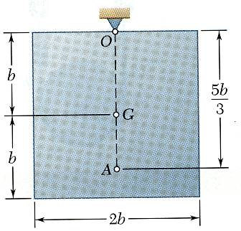


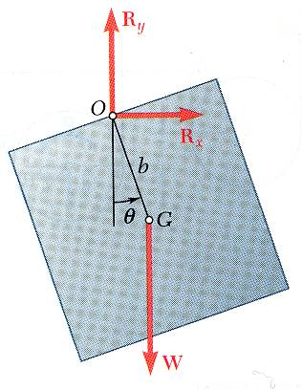
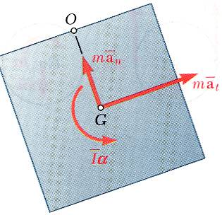
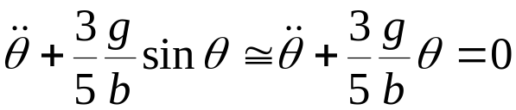

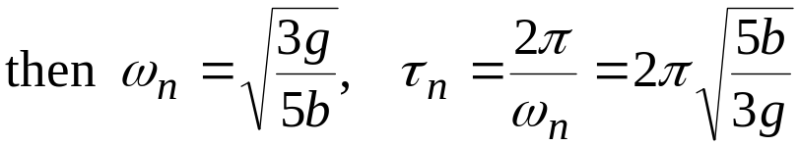

Free Vibrations of Rigid Bodies
If an equation of motion takes the form
the corresponding motion may be considered as simple harmonic motion.
Analysis objective is to determine ω_{n}.
Consider the oscillations of a square plate
For an equivalent simple pendulum,
19 - <number>

Slide 23

Sample Problem 19.2
SOLUTION:
From the kinematics of the system, relate the linear displacement and acceleration to the rotation of the cylinder.
k
Based on a free-body-diagram equation for the equivalence of the external and effective forces, write the equation of motion.
A cylinder of weight W is suspended as shown.
Determine the period and natural frequency of vibrations of the cylinder.
Substitute the kinematic relations to arrive at an equation involving only the angular displacement and acceleration.
19 - <number>

Slide 24














Sample Problem 19.2
SOLUTION:
From the kinematics of the system, relate the linear displacement and acceleration to the rotation of the cylinder.
Based on a free-body-diagram equation for the equivalence of the external and effective forces, write the equation of motion.
Substitute the kinematic relations to arrive at an equation involving only the angular displacement and acceleration.
19 - <number>

Slide 25

Sample Problem 19.3
A 32-kg block attached to a spring of constant k = 12 kN/m can
move without friction in a slot as shown. The block is given an
initial 300-mm displacement downward from its equilibrium position
and released. Determine, 1.5 s after the block has been released (a) the total distance traveled by the block, (b) the acceleration of the block.
19 - <number>

Slide 26

Sample Problem 19.3
19 - <number>

